Slide 1
Find:
A pair of numbers that add to 4 and multiply to 4
A pair of numbers that add to 0 and multiply to negative 4
A pair of numbers that add to 0 and multiply to negative 9
Bonus: A pair of numbers that add to zero and multiply to 10

Slide 2
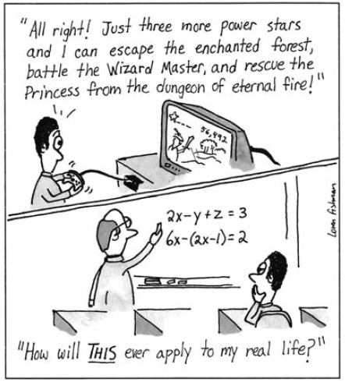

Slide 3
24
7
30
Date
Factorising
EQ – Can you use the difference of perfect squares to help factorise?
a² - b²
=
( ) ( )
a + b
a - b
This is a
difference of squares
Which can
be written as a product
Lets check this by expansion of (a + b)(a – b)
= a² + ab – ab - b² (Using the FOIL method)
= a² – b²

Slide 4


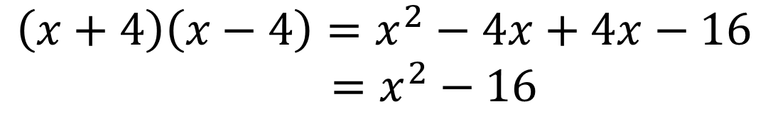

24
7
30
Date
Factorising
EQ – Can you use the difference of perfect squares to help factorise?
a² - b²
=
( ) ( )
a + b
a - b
$$x^{2}−16$$
$${=x}^{2}−4^{2}$$
$$=(x+4)(x−4)$$
Lets check this by expansion using the FOIL method
$$\left(x+4\right)\left(x−4\right)=x^{2}−4x+4x−16$$
$=x^{2}−16$

Slide 5


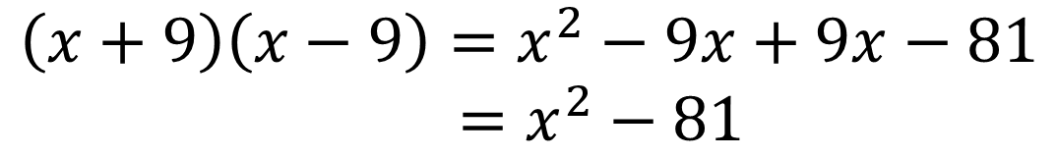

24
7
30
Date
Factorising
EQ – Can you use the difference of perfect squares to help factorise?
a² - b²
=
( ) ( )
a + b
a - b
$$x^{2}−81$$
$${=x}^{2}−9^{2}$$
$$=(x+9)(x−9)$$
Lets check this by expansion using the FOIL method
$$\left(x+9\right)\left(x−9\right)=x^{2}−9x+9x−81$$
$=x^{2}−81$

Slide 6


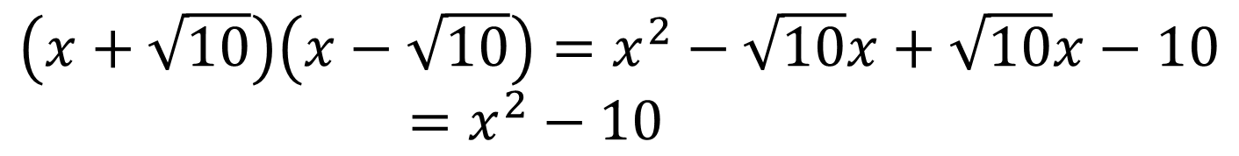

24
7
30
Date
Factorising
EQ – Can you use the difference of perfect squares to help factorise?
a² - b²
=
( ) ( )
a + b
a - b
$$x^{2}−10$$
Now there is no easy way to do it, you need the square root!
$${=x}^{2}−{(\sqrt{10})}^{2}$$
$$=(x+\sqrt{10})(x−\sqrt{10})$$
Lets check this by expansion using the FOIL method
$$\left(x+\sqrt{10}\right)\left(x−\sqrt{10}\right)=x^{2}−\sqrt{10}x+\sqrt{10}x−10$$
$=x^{2}−10$

Slide 7



24
7
30
Date
Factorising
EQ – Can you use the difference of perfect squares to help factorise?
a² - b²
=
( ) ( )
a + b
a - b
$${(x+1)}^{2}−4$$
$${=(x+1)}^{2}−2^{2}$$
Lets call (x+1) = a and 2 = b
$$=(\left(x+1\right)+2)(\left(x+1\right)−2)$$
This is (a+b)(a-b)
$$=(x+3)(x−1)$$

Slide 8
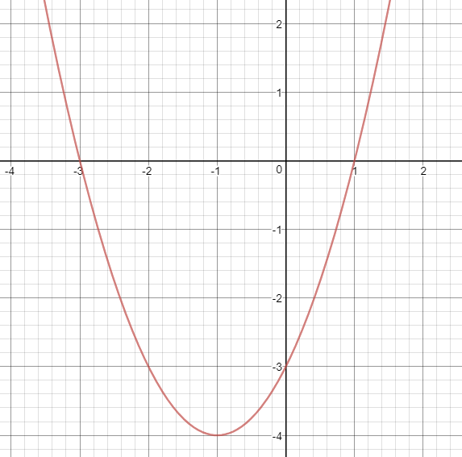


24
7
30
Date
Factorising
EQ – Can you use the difference of perfect squares to help factorise?
$${(x+1)}^{2}−4$$
$$=(x+3)(x−1)$$
Looking ahead to later in the year we can see that factorising shows us some interesting points on a graph

Slide 9

Do you understand? Fists of Five
Notes:
Check for Understanding

Slide 10






Now your turn
Have a go at the following
$$x^{2}−25$$
$${(x−2)}^{2}−36$$
$$x^{2}−49$$
$${(x+9)}^{2}−25$$
$$x^{2}−20$$
$${(x−5)}^{2}−8$$

